Slide 1




SCUTTLE Software Guide
revised 2021.07.22
Software Architecture
Software best practices
Sensor Communication
Obstacle Avoidance
See errors? Inform scuttleProject@gmail.com

Slide 2



Software Architecture
CONTENTS
This guide covers
The parts of each software file
How the programs interact with each other
How the programs interact with hardware
Sensor software vs actuator software
LANGUAGE
The SCUTTLE robot software has been programmed in Python3 on an embedded Linux platform. Both Beaglebone Blue and Raspberry Pi have been tested successfully. The software has been architected to make a robust starting point for students to create their own autonomous missions. These slides detail the software architecture.
FUTURE OUTLOOK
Next Steps: Robotic Operating System 2 (ROS2) is quickly becoming a reliable, versatile software platform for mobile robots. During 2021 the SCUTTLE team will aim to create a new ROS2 version of the software.
See errors? Inform scuttleProject@gmail.com

Slide 3
Software Architecture – Introduction
The blocks in yellow are sensors, and the items in orange are actuators or other outputs. The level-2 blocks in teal are specific to the hardware platform (beagle, pi, etc) and perform communication with the low level devices. The blocks of level2 and above are non-hardware specific.
Each block aside from sensors and actuators represent an individual python program. The purple text indicates what important information is passed between programs and the black arrows indicate (for the most part) what direction the data is flowing. If a level 3 program needs information from another, it must receive the information from the top-level program, in order to maintain the structure of independence in program functions.
This software structure is preferred in order to perform subsystem testing. The data flowing through the top level is minimal and can be replaced with artificial data in the even that a sensor is unavailable.
Sensors
Actuators
programs
programs
data
[var_A, var_B]
See errors? Inform scuttleProject@gmail.com

Slide 4
Software Architecture - Overview
L3_drive_mt.py
multithreading driving
[x_dot,
theta_dot]
[target_phi_dot_L,
target_phi_dot_R]
[nearest obstacle]
[target_phi_dot_L,
target_phi_dot_R]
[text string]
Wheel Encoders Column
Game Controller Column
LIDAR column
Motor Driver Column
Audio Output Column
Color Key
Sensors
L2_kinematics.py
compute chassis movement
L2_inverse_kinematics.py compute wheel vectors
L2_obstacle.py
compute obstacles
L2_speed_control.py
generate wheel duty cycle commands
cpu clock
Actuators
[phiL, phiR]
[target_x_dot,
target_theta_dot]
+14 values
[array of distances & angles]
[duty_L,duty_R]
Level 2 Program (logic-defining)
L1_encoder.py
get the information from encoders
L1_gamepad.py get the information from gamepad
L1_lidar.py
get the information from lidar
L1_motors.py
generate 4 signals to output pins
L1_text2speech.py
generate audio signals for aux output
Level 1 Program (hardware-specific)
[pwmA, pwmB, pwmC,pwmD]
analog
audio
Left Encoder 0x40
Right encoder 0x41
GamePad controller
LIDAR TiM561
Motor Driver inputs 1,2
Motor Driver inputs 3,4
Audio Driver
See errors? Inform scuttleProject@gmail.com

Slide 5
Software Architecture – Overview (continued)
to the L3 program
Sensors column
Camera column
Servo Column
Data logging column
Color Key
[battery info] or
[temp, press] or
[mpu data]
[target_x_dot,
target_theta_dot]
[array of commands]
[data to
be logged]
Sensors
L2_onboard.py
compute battery info
L2_track_target.py
compute steering
Actuators
[target_x,
target_y, target_radius]
Code Modules (logic-defining)
[bmp
values]
[adc
values]
[mpu
values]
L1_bmp.py
get bmp data
L1_adc.py
get adc data
L1_mpu.py
get mpu data
L1_camera.py get the image from camera
L1_servo.py
send commands to servos
L2_log.py
code modules (hardware-specific)
servo command
servo command
[strings]
BMP280
enviro sensor
ADC
voltage sensor
MPU9250
motion sensor
USB
camera
Servo 1
…
Servo 8
myLog.csv
data log
See errors? Inform scuttleProject@gmail.com

Slide 6
Libraries in use:
Python importing guidelines:
Each file should import the files below it in hierarchy, and not the files above it.
Each file may import non-scuttle libraries as needed (import NumPy, import time, etc.)
If the Level-1 file has imported an external library, it does not need to be imported by the Level-2 file
Libraries Utilized:
BeagleBone Blue Integration:
RCPY for communicating with MPU9250 & commanding motor drivers
Adafruit GPIO for I2C Communication
BMP280 for communicating with the onboard bmp280 sensor.
Raspberry Pi integration:
pysicktim for accessing LIDAR data
gpiozero for controlling GPIO pins.
Common Libraries
os for making shell commands via python code.
time for keeping track of time
threading for performing multithreading
NumPy for performing math operations
Fastlogging for generating log files
pygame for accessing gamepad controller data
cayenne.client for sending MQTT messages
smbus2 for accessing i2c bus through python commands
See errors? Inform scuttleProject@gmail.com

Slide 7
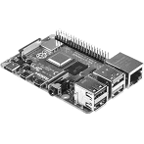
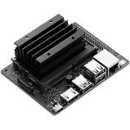
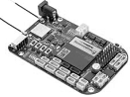
Libraries Matrix
Lib | Beaglebone Blue | Raspberry Pi 3B+ and 4 | Jetson Nano [Under development]
Time | ✔ | ✔ | ✔
Threading | ✔ | ✔ | ✔
numpy | ✔ | ✔ | ✔
pygame | ✔ | ✔
fastlogging | ✔ | ✔ | ✔
Cayenne.client | ✔ | ✔
PySICKtim |  | ✔
GPIOZERO |  | ✔
RCPY | ✔
ADAFRUIT GPIO | ✔
BMP280 | ✔
See errors? Inform scuttleProject@gmail.com

Slide 8
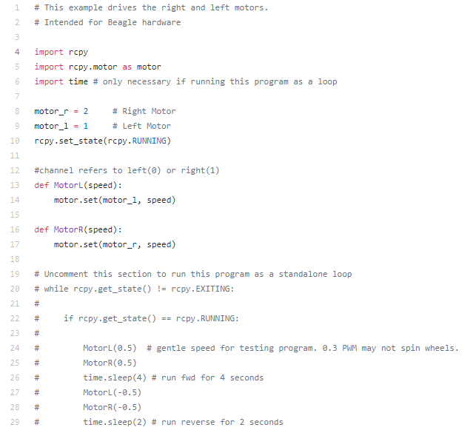
Outline of an L1 Program
All files follow this outline when possible. The level-1 programs are most suited to this outline.
Explanation of the purpose
Import internal programs (if applicable)
Import external programs (aka libraries). Take actions for initializations of objects or global variables.
Define functions. In some cases, make functions that combine other functions in sequence.
Offer a simplified, minimal loop for testing the code.
See errors? Inform scuttleProject@gmail.com

Slide 9
Guidelines for Levels
pass data to L3
Importing
Files & Libraries
Testing
Code and Hardware
[data relevant
to the mission]
Only import L1 programs directly below. Do not import L3 program. As needed, import external libraries.
L2_program.py
compute parameters from L1 data
This file has a loop to test the whole group (L1 + L2 + sensor).
[raw data
subset]
Do not import L2 or L3 programs. As needed, import external libraries.
L1_program.py
get the data from sensor
This file has a loop to test sensor function.
[raw sensor
data]
Sensor
actual hardware
See errors? Inform scuttleProject@gmail.com

Slide 10
Multi-threading Purpose
Threading offers better control over timing of code execution.
Each thread should contain actions that are related and that should be executed within a specific time window.
The user should avoid passing data between threads because it reduces robustness. Instead, call the level 2 program as needed in each thread, even if you need to communicate with the same device (ie, retrieve gamepad commands for driving and retrieve in parallel for speaking commands)
Thread 1 (driving)
Thread 2 (obstacle detect)
Thread 3 (speaking)
Do What?
Drive the robot
Indicate obstacles using speaker
speak via speaker
AND
Log the speed
user presses button
When?
when obstacle is detected by lidar
After sampling the controller
After sending drive command
20ms cylcle
10ms cylcle
5ms cylcle
See errors? Inform scuttleProject@gmail.com

Slide 11
Software Architecture: Sensors vs Actuators
pass data to L3
pass command from L3
Sensor and Actuators have the same architecture except for data direction.
For sensors, the data is generated at the hardware and sent UP.
For actuators, the data is generated at the top and sent DOWN to hardware.
Some sensors and actuators have feedback and preset commands, so data may flow both ways.
Sensors
Actuators
[data relevant
to the mission]
[message from
the mission]
L2_program.py
compute parameters from L1 data
L2_program.py
compute commands for L1 program
[raw data
subset]
[message for
L1 program]
L1_program.py
get the data from sensor
L1_program.py
send commands to actuator
[raw sensor
data]
[message for actuator]
Sensor
actual hardware
Actuator
actual hardware
See errors? Inform scuttleProject@gmail.com

Slide 12
Software Architecture: Modularity & Robustness
pass data to L3
Send and receives data in the format that is “universal” or standardized.
If there is a hardware change, this program does not need to change
If the driving strategy changes, this program may change
[data relevant
to the mission]
L2_program.py
compute parameters from L1 data
[raw data
subset]
The job of L1 program is to convert the data into the desired format.
If there is a hardware change, only these items need to be updated.
If the driving strategy changes, these items do not change.
L1_program.py
get the data from sensor
[raw sensor
data]
Sensor
actual hardware
See errors? Inform scuttleProject@gmail.com

Slide 13
Level 1: logging
Rather than interacting with hardware, the L1_log program interacts with other python files. It acts as a sensor in that it retrieves recorded data and it acts as an actuator in that it can receive data and perform an action with it (store it in a file).
L1_log.py program was initially designated as level2, but is being set as L1 going forward (2020.11)
functions:
logSpeeds()
logError()
logNewDataType()
L1_log.py
compute parameters from L1 data
myErrorLog.csv
data log
myLogMsg.txt
data log
+ new log.csv
created data log
info for nodeRed charts
Info retrieved for text2speech
See errors? Inform scuttleProject@gmail.com

Slide 14
Multithreading example
Color Key
Sensors
L3_drive_mt.py
multithreading driving
Actuators
L3_tellHeading.py
declare robot heading on speaker
Level 2 Program (logic-defining)
[x_dot,
theta_dot]
[target_phi_dot_L,
target_phi_dot_R]
[target_phi_dot_L,
target_phi_dot_R]
Level 1 Program (hardware-specific)
Wheel Encoders Column
Game Controller Column
Motor Driver Column
Compass column
Audio Output Column
[heading (degrees)]
L2_kinematics.py
compute chassis movement
L2_inverse_kinematics.py compute wheel vectors
L2_speed_control.py
generate wheel duty cycle commands
L2_heading.py
compute steering
cpu clock
[text string]
[phiL, phiR]
[target_x_dot,
target_theta_dot]
+14 values
[duty_L,duty_R]
[tcompass_x,
tcompass_y]
L1_encoder.py
get the information from encoders
L1_gamepad.py get the information from gamepad
L1_motors.py
generate 4 signals to output pins
compass driver in RCPY Lib
L1_text2speech.py
generate audio signals for aux output
[pwmA, pwmB, pwmC,pwmD]
analog
audio
Left Encoder 0x40
Right encoder 0x41
GamePad controller
Motor Driver inputs 1,2
Motor Driver inputs 3,4
mpu sensor
Audio Driver
See errors? Inform scuttleProject@gmail.com

Slide 15
Color Tracking Example
L3_follow.py
Object Following
[target offset
[-1,1] ]
Camera Column
Kinematics Column
Motor Driver column
Color Key
[target offset from center]
[target_phi_dot_L,
target_phi_dot_R]
[target speeds]
Sensors
L2_track_target.py
Finds color target in range
L2_inverse_kinematics.py
Compute wheel vectors
L2_speed_control.py
Converts speeds into duty cycles
Actuators
Level 2 Program (logic-defining)
[image]
[duty cycles]
Level 1 Program (hardware-specific)
L1_camera.py
Get image from USB camera
L1_gamepad.py
Not used
L1_motor.py
Generate signals to output pins
[pwmA, pwmB, pwmC,pwmD]
Wide-Angle Camera
Motor Driver inputs 1,2
Motor Driver inputs 3,4
See errors? Inform scuttleProject@gmail.com

Slide 16
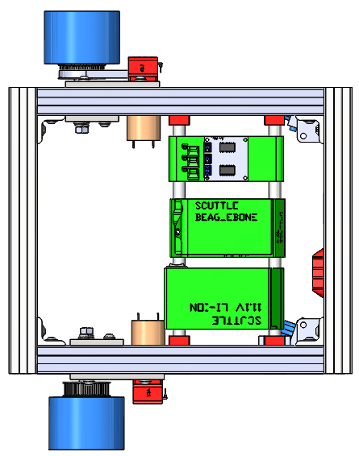
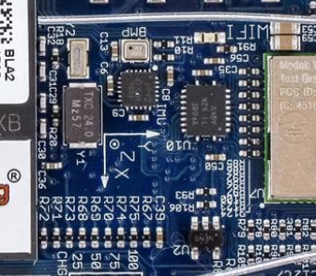
Absolute Orientation
SCUTTLE has a compass for orientation
The compass is nothing but a 3-axis magnetometer
Encoders can provide relative orientation
Compass is required for global orientation
The compass is embedded in the IMU (MPU-9250)
It has 3 sensors oriented in the indicated directions
L1_mpu.py accesses the magnetometer
Each magnetometer requires calibration
Remember: Theta is defined as scuttle’s chassis x-vector minus the global x-vector
x
this theta is positive
ϴ_{c}
Y’
global coordinate frame
x’
See errors? Inform scuttleProject@gmail.com

Slide 17


Magnetometer Behavior
An axis is at its MAXIMUM when it is aligned NORTH
The axis is at its MINIMUM when it is opposing NORTH
After calibration, we can achieve the behavior below
1) Discover the maximum and minimum values by rotating sensor in a full circle.
Permanent magnets influence the sensor, so calibration must be done on the robot, in position near the motors.
Values Desired by Direction
Using X axis for example:
Before Calibration | Min (microtesla) | max (microtesla)
X | -15 | 38
Y | -22 | 20
2) Using the following equation, re-scale each axis
x_{c} = 0
x_{c} = 1
x_{c} = 0
x_{c} = -1
$$x_{scaled}=\frac{2(x −x_{min})}{(x_{max}−x_{min})}−(1)$$
(magnetic north)
AfterCalibration | Min (ratio to max) | max (ratio to max)
X | -1 | 1
Y | -1 | 1
See errors? Inform scuttleProject@gmail.com

Slide 18
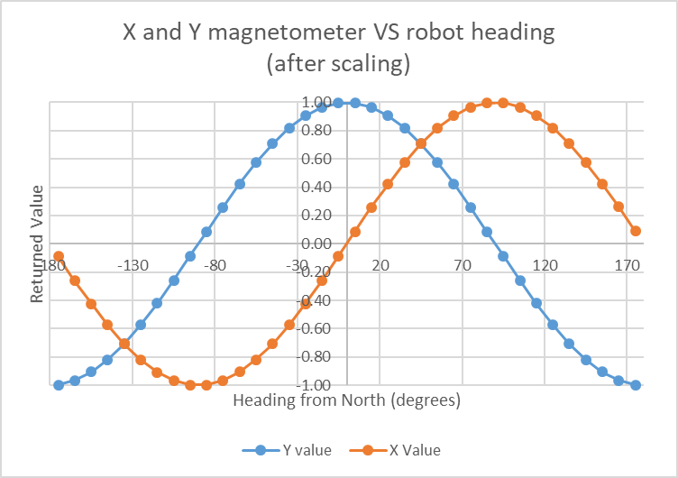
Determining Absolute Orientation
X and Y axes are sufficient information to give heading.
Z axis returns zero if scuttle sits flat
Theta is defined as rotation of SCUTTLE from the global coordinate frame, or y-prime
positive theta means SCUTTLE is turned left from north
We can define NORTH as the y-axis of the global coordinate frame
Theta is positive when scuttle points west
Theta is negative when scuttle points east
Use arctan2(y, x) to return a heading
arctan2 is the "element-wise arc tangent of y/x choosing the quadrant correctly."
Example:
ATAN2(0.91, 0.42) returns 25 degrees
y-prime
y = 0.91
x = 0.42
y is pointed strongly north
X is pointed weakly north
both axes return positive values
See errors? Inform scuttleProject@gmail.com

Slide 19


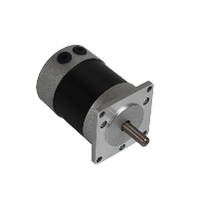


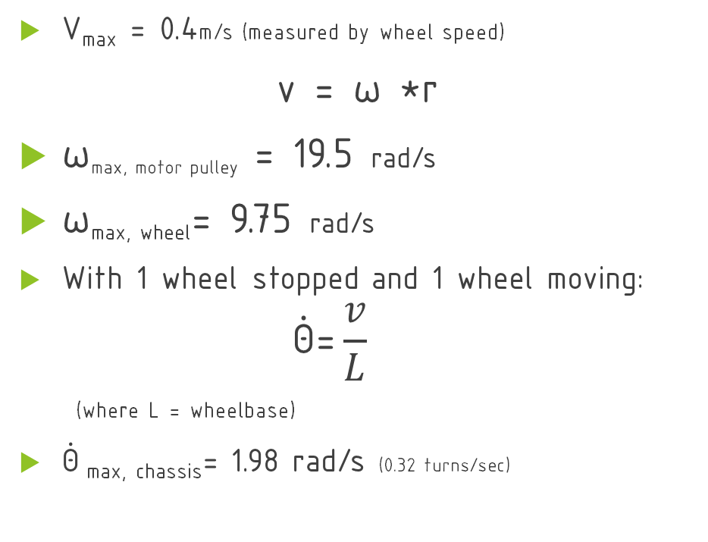
Speeds Tuning
These are general performance characteristics you can expect when using the standard SCUTTLE hardware:
V_{max} = 0.4m/s (measured by wheel speed)
v = ω *r
ω_{max, motor pulley} = 19.5 rad/s
ω_{max, wheel}= 9.75 rad/s
With 1 wheel stopped and 1 wheel moving:
$$\dot{\text{Θ}}\text{=}\frac{v}{L}$$
(where L = wheelbase)
$\dot{\text{Θ}}$_{max, chassis}= 1.98 rad/s (0.32 turns/sec)
Nominal conditions:
Battery: 11.5 volts OC
Motors: equipped with standard 200 rpm gearbox
Wheels: 83mm diameter urethane wheels
Pulleys: motor = 15 teeth, wheel = 30 teeth
Wheelbase: 405mm
See errors? Inform scuttleProject@gmail.com

Slide 20
Speeds Tuning
These are general performance characteristics you can expect when using the standard SCUTTLE hardware:
V_{max} = 0.4m/s (measured by wheel speed)
v = ω *r
ω_{max, motor pulley} = 19.5 rad/s
ω_{max, wheel}= 9.75 rad/s
With 1 wheel stopped and 1 wheel moving:
$$\dot{\text{Θ}}\text{=}\frac{v}{L}$$
(where L = wheelbase)
$\dot{\text{Θ}}$_{max, chassis}= 1.98 rad/s (0.32 turns/sec)
Nominal conditions:
Battery: 11.5 volts OC
Motors: equipped with standard 200 rpm gearbox
Wheels: 83mm diameter urethane wheels
Pulleys: motor = 15 teeth, wheel = 30 teeth
Wheelbase: 405mm
See errors? Inform scuttleProject@gmail.com

Slide 21
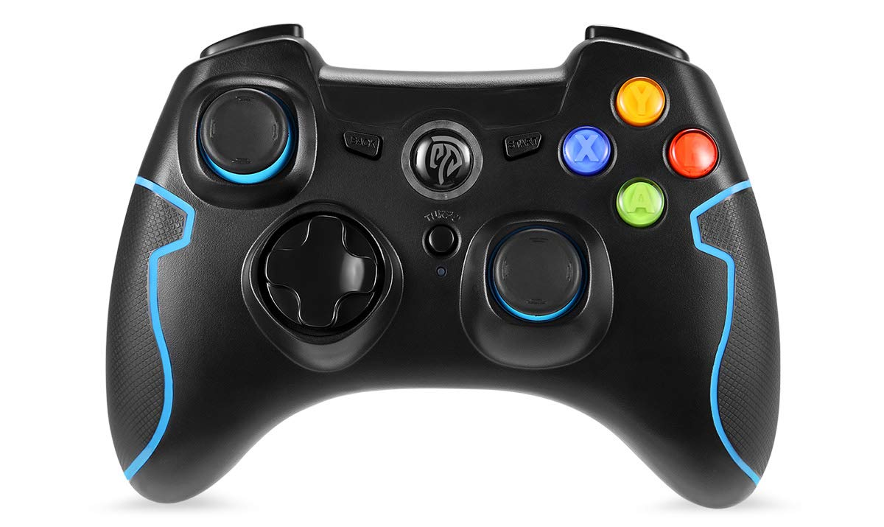
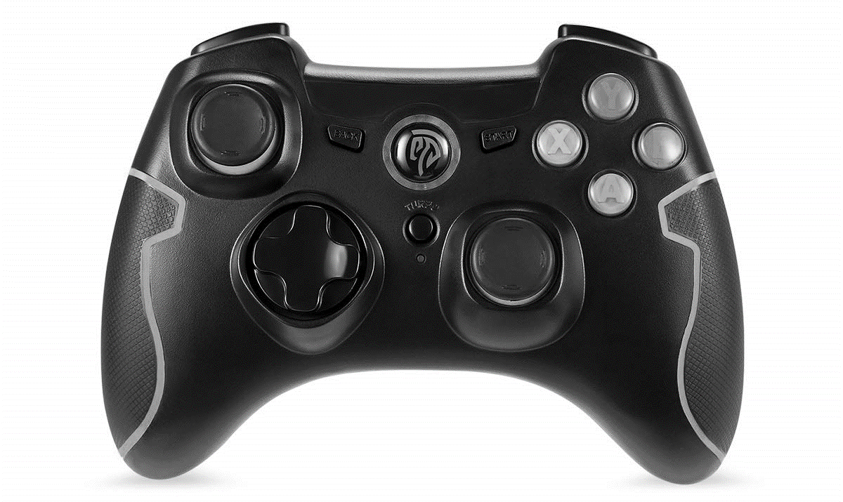


SCUTTLE Driving
The left joystick operates the robot wheels
The forward/backward axis will request a speed
(A.K.A movement in x)
The left/right axis will request an angular velocity
(A.K.A movement in theta)
requests $\dot{x}$
Given a measured max forward velocity of 0.4m/s, the other maximums are calculated.
requests $\dot{\text{ϴ} }$
Move | Theta_dot (rad/s) | X_dot (m/s) | Phi_dot
max | 1.99 | 0.4 | 9.75
Gamepad Controls Mapping
Trigger: B6
B4
Trigger: B7
B5
B10
axis 0+
select proper mode
B0
B8
B9
B3
B1
axis 1+
B11
B2
axis 2+
axis 3+
See errors? Inform scuttleProject@gmail.com

Slide 22
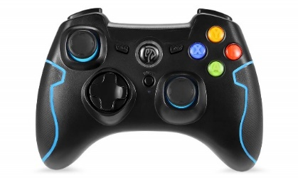
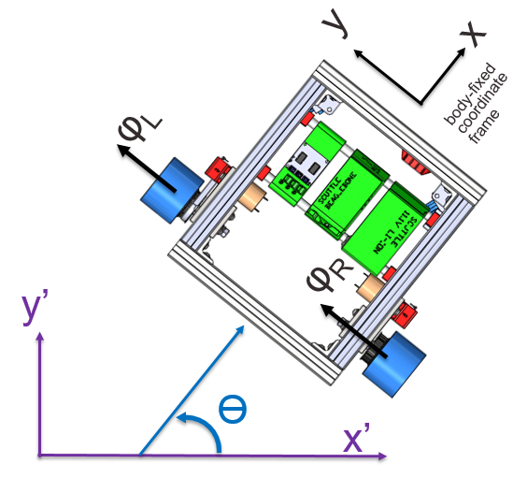
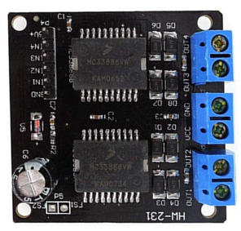
SCUTTLE Movement Example
USER SAYS
right turn on joystick
GAMEPAD SAYS
outputs positive value on axis_1
KINEMATICS SAYS
interpret as negative theta movement
Move | Theta_dot | X_dot | Duty_r | Duty_l
Fwd | 0 | 1 | 1 | 1
Rev | 0 | -1 | -1 | -1
right | -1 | 0 | -1 | 1
left | +1 | 0 | 1 | -1
KINEMATICS SAYS
performs
POSTIVE phi_dot_l and NEGATIVE phi_dot_R
MOTOR PROGRAM SAYS
performs
POSTIVE differential on NEGATIVE phi_dot_R
See errors? Inform scuttleProject@gmail.com

Slide 23

SCUTTLE Color Tracking
1) SCUTTLE turns until the target is detected within the threshold
2) After the target is in the center range, SCUTTLE drives forward or backwards to reach a target radius, in pixels.
Center
Threshold
Radius=15 pixels
Drive forward
Radius=20 pixels
150˚
Drive backward
Wide-Angle
Camera
Wide-Angle
Camera

Slide 24
LIDAR Concept of Operation
maximum range
ANATOMY
Lidar systems have a rotating sensor collecting multiple measurements to measure in a 2D plane. (Some have 3D, by other methods).
METHOD
Lidar emits a beam of light and receives the reflection. distance is based on Time of Flight concept.
POWER
TiM561 uses about 2.1 watts during operation, mainly due to driving the motor and driving a strong IR emitter diode.
FAILURE MODES
Just like light, a Lidar beam can be absorbed by very dark objects and can be mis-directed by highly reflective objects which are non-perpendicular to the beam.
DATA QUALITY
The lidar has variable resolution in a sense! 0.33 degrees offers 5mm point spacing at a 1m distance, and at 10 meters, 50mm point spacing.
APPROPRIATE USE
To be successful in using the device, you need to see the datasheet to understand the parameters of your device.
Wall
d
Lidar Device
See errors? Inform scuttleProject@gmail.com

Slide 25
LIDAR – measuring a point
P₁ is the location of the lidar.
The points will be initially measured from lidar and returned as pairs given by:
[d (mm), α (degrees)]
Python’s numpy library performs math in radians. It is easy to convert back and forth but you must be aware of your units.
Obstacle of Interest
P₂
d
d_{y}
α
LIDAR location
d_{x}
Center of Wheelbase
P₀
P₁
See errors? Inform scuttleProject@gmail.com

Slide 26
Software For LIDAR
Lab8Template.py
Get the P2 vector & send to nodeRed
Key Points:
Software is using the numPy library to handle vectors and matrices. numPy computation is faster than raw python and requires proper syntax.
Lidar scan frequency: 15hz, so you cannot get new measurements faster than 66ms.
L1_lidar.py returns 54 measurements by default and can return over 800 single points if desired, for more resolution.
TiM561 LIDAR returns distances in meters. Distances under 16mm are returned as error codes in case of poor reflection or other problem for a given measurement.
L2_vector.py can manipulate measurements, with functions such as returning the nearest point, combining cartesian vectors, and converting vectors from polar to Cartesian coordinates.
[nearest obstacle vector]
LIDAR column
Color Key
Sensors
L2_vector.py
compute obstacles
Actuators
[array of distances & angles] (54x2)
Level 2 Program (logic-defining)
L1_lidar.py
get the information from lidar
Level 1 Program (hardware-specific)
LIDAR TiM561
See errors? Inform scuttleProject@gmail.com

Slide 27
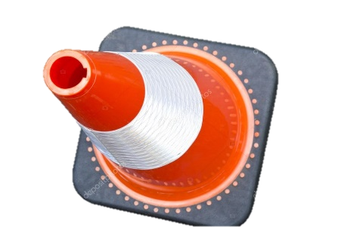
Global Location of Obstacle
Determine the global location of an obstacle:
You must add vector r₀ and vector r₀₂
First, your vector r₀₂ must be generated using knowledge of the location of the LIDAR on the robot.
P₂
r₀₋₂
Where is the obstacle located in the room?
vector r₀₂
is not given automatically.
P₀
y’
P₁
r₀
x’
global coordinate frame
See errors? Inform scuttleProject@gmail.com

Slide 28
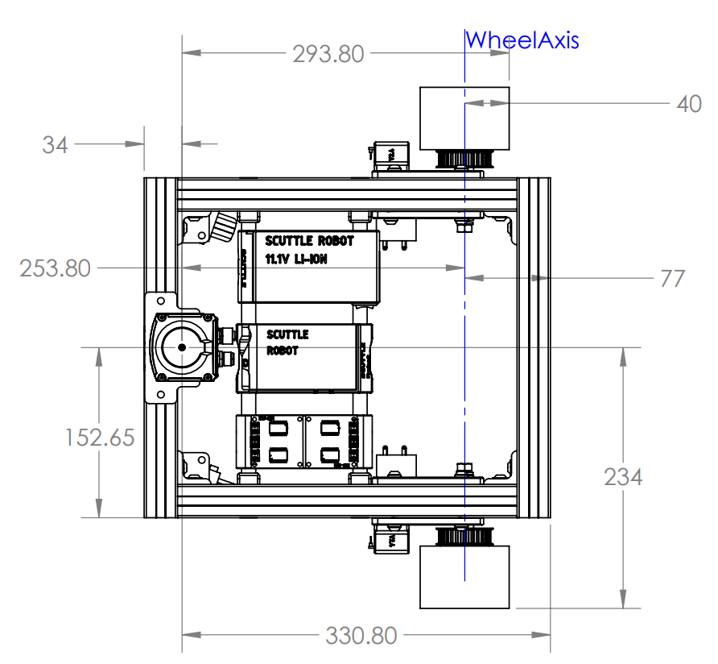
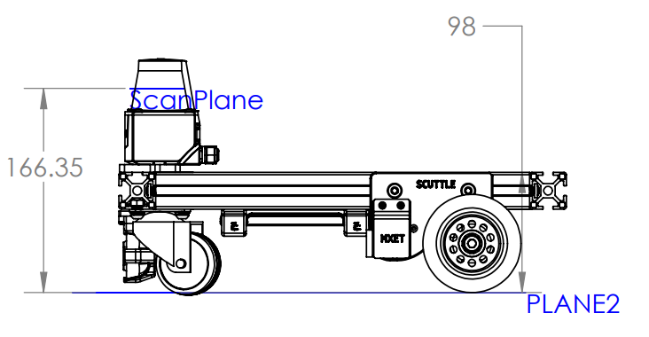
Global Location of Obstacle
Determine the global location of an obstacle:
Lidar is located at positive 254mm in the x-direction on the robot.
The lidar beam is 166 mm above the floor.
See errors? Inform scuttleProject@gmail.com

Slide 29
Obstacle Avoidance by LIDAR
One method to avoid obstacles is to generate an imaginary spring which pushes on your robot and depends on the nearest obstacle.
D_{y} is the y-component of distance d
D_{x} is the x-component of distance d
Wall
P₂
d
d_{y}
α
d_{x}
P₁
See errors? Inform scuttleProject@gmail.com

Slide 30
Obstacle Avoidance by LIDAR
Strategy:
The obstacle avoidance feature will try to detect the nearest objects to the robot and apply an “invisible force” to prevent the robot from crashing. The force is intended to act like a spring which is anchored to the nearest obstacle and pushes the robot at a point on the body, referred to as P1.
P₂
d
Wall
P₁
The obstacle avoidance only deals with the body-fixed frame
Define P₁ as a point of interest on our robot.
P₂ is assigned to the nearest point detected by the LIDAR scan.
d is the distance between point 1 and point 2
We would like to handle all of these variables in:
body-fixed frame
Cartesian coordinates
P₀
See errors? Inform scuttleProject@gmail.com

Slide 31
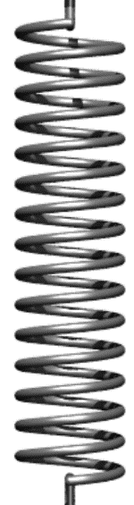
Obstacle Avoidance – influence on velocity (translational and angular)
If P2 is detected straight ahead, the force influences velocity
If P2 is detected at the side, the force influences steering
If P2 is detected at an angle, the force will influence both
P₂
P₂
LIDAR location
P₂
See errors? Inform scuttleProject@gmail.com

Slide 32
Obstacle Avoidance – Variable Force
If d is large, the force is low
If d is small, the force is high
If d is larger than d_{max}, the force is absent
P₂
small
force
large
force
P₁
See errors? Inform scuttleProject@gmail.com

Slide 33
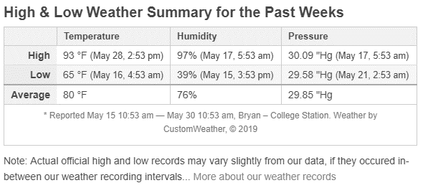
Quick Dive – Barometric Pressure
COLLEGE STATION 4-DAY CHANGE
delta in pressure is 30.09-29.58 “Hg ➔ 0.51” Hg
delta pressure = 1.73kPa
STANDARD PRESSURE CALCULATIONS
sea level std pressure: 101.3kPa
pressure at 1000ft: 97.7kPa
delta pressure = 3.6kPa
elevation change represented by 1kPa = 278ft
Historic weather at timeanddate.com
What the Barometric pressure will tell you:
1.73kPa change in pressure will represent 480ft altitude change.
See errors? Inform scuttleProject@gmail.com

Slide 34
Speed Control
Update Shaft positions (take reading)
Get Wheel Increments
Update Phis
Update PhiDots
Chassis displacement
Measure position
Capture time
Just math
Integrate the wheel positions
Take derivatives
Update latest wheelspeeds
Chassis speeds
Compute the displacement in theta and x
Take derivative of last movements w.r.t. change in time since last sample.
10hz is sufficient
This slide is dedicated to describing the wheel speed measurements and calculation of variables for speed control.
Nominal conditions:
Battery: 11.5 volts, open circuit
Motors: equipped with standard 200 rpm gearbox
Wheels: 83mm diameter urethane wheels
Pulleys: motor = 15 teeth, wheel = 30 teeth
See errors? Inform scuttleProject@gmail.com

Slide 35
Further Reading
https://en.wikipedia.org/wiki/Holonomic_(robotics)
Connector types
http://dangerousprototypes.com/blog/2017/06/22/dirty-cables-whats-in-that-pile/
See errors? Inform scuttleProject@gmail.com

